Slide 1
Games and Adversarial Search
Fundamentals of Artificial Intelligence
Slides are mostly adapted from AIMA, MIT Open Courseware and
Svetlana Lazebnik (UIUC)
Spring 2008

Slide 2
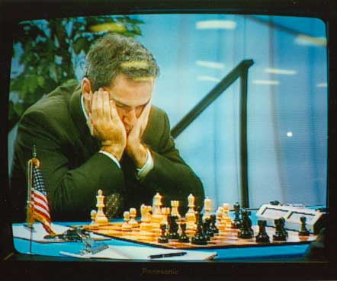
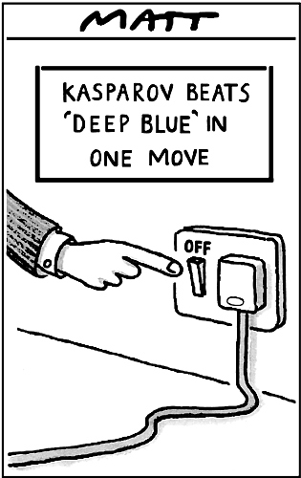
World Champion chess player Garry Kasparov is defeated by
IBM’s Deep Blue chess-playing computer in a
six-game match in May, 1997
(link)
© Telegraph Group Unlimited 1997
© Telegraph Group Unlimited 1997
Notes:
Games have been considered as a way of representing intellectual capabilities of humans.
They allow an abstract competition without going into a war.
This abstraction made game playing also an appealing target for AI
And as we have discussed in the introduction AI systems achieved impressive success in many games.
But of course sometimes it may depend only a single move of a human to beat a machine ☺

Slide 3
Why study games?
Games are a traditional hallmark of intelligence
Games are easy to formalize
Games can be a good model of real-world competitive or cooperative activities
  Military confrontations, negotiation, auctions, etc.
Notes:
Besides being a representation of intelligence, games are also appealing for AI since
They are easy to formalize as agents are usually restricted to a fairly small number of well defined actions
Game playing is an idealization of worlds in which hostile agents act so as to diminish one’s well being.
They can be considered as a good model of real world competitive or cooperative activities, as well.

Slide 4
Games – history of chess playing
1949 – Shannon paper – originated the ideas
1951 – Turing paper – hand simulation
1958 – Bernstein program
1955-1960 – Simon-Newell program
1961 – Soviet program
1966 – 1967 – MacHack 6 – defeated a good player
1970s – NW chess 4.5
1980s – Cray Bitz
1990s – Belle, Hitech, Deep Thought,
1997 - Deep Blue - defeated Garry Kasparov
CS461 Artificial Intelligence © Pinar Duygulu
Spring 2008
Notes:
Almost as soon as computer became programmable, the first chess programs were written by Claude Shannon (the inventor of information theory ) and by Alan Turing
Since then there has been a steady progress
And in 1997 Deep Blue defeated world champion.

Slide 5
Games
Multi agent environments : any given agent will need to consider the actions of other agents and how they affect its own welfare.
The unpredictability of these other agents can introduce many possible contingencies
There could be competitive or cooperative environments
Competitive environments, in which the agent’s goals are in conflict require adversarial search – these problems are called as games
CS461 Artificial Intelligence © Pinar Duygulu
Spring 2008
Notes:
Winning chess was nice as a proof for machines doing something that requires intelligence
But choice of chess was also because of the simplicity of its rules, and the fact that the world state is fully accessible to the program
It is easy to represent the game as a search through a space of possible game positions.
However, the presence of an opponent makes the decision problem more complicated than the search problems that we have
discussed previously
All game playing programs must deal with the contingency problem.
The uncertainty is not because of throwing a dice or uncertainty in predicting the goal.

Slide 6
Games vs. single-agent search
We don’t know how the opponent will act
  The solution is not a fixed sequence of actions from start state to goal state, but a strategy or policy (a mapping from state to best move in that state)
Efficiency is critical to playing well
  The time to make a move is limited
  The branching factor, search depth, and number of terminal configurations are huge
    In chess, branching factor ≈ 35 and depth ≈ 100, giving a search tree of 10¹⁵⁴ nodes
      Number of atoms in the observable universe ≈ 10⁸⁰
  This rules out searching all the way to the end of the game
Notes:
The opponent introduces uncertainty because we don’t know what he or she would do
Therefore we require a strategy or policy to decide the best move in any state
Most importantly games are much harder to solve
In chess the branching factor is around 35 and games often go to 50 moves by each player.
Therefore the complexity is 35^100
And thus it is impossible to search till to the end of the game.

Slide 7
Types of game environments
 | Deterministic | Stochastic
Perfect information (fully observable)
Imperfect information (partially observable)
Chess, checkers, go
Backgammon, monopoly
Battleships
Scrabble, poker, bridge
Notes:
Furthermore, there are many types of games.
Chess is a deterministic and fully observable game similar to checkers and go
We see the full board, and positions of all pieces.
In backgammon again the positions are fully visible we have also a chance factor because of dice rolling.
On the other hand in games like battleship you do not see the positions of the opponent’s pieces, thus it is a partially observable environment
And finally games like poker and bridge are the most difficult ones since they include a chance factor in a partially observable environment
First, we will discuss deterministic games with perfect information.
We will discuss how we can find the theoretical best move.
Then we will look at the techniques for choosing a good move when time is limited.
We will discuss pruning and use of heuristic evaluation functions.
Then we will discuss stochastic games with imperfect information
and finally we will shortly introduce the games with imperfect information

Slide 8
Games
In game theory (economics), any multiagent environment (either cooperative or competitive) is a game provided that the impact of each agent on the other is significant
AI games are a specialized kind - deterministic, turn taking, two-player, zero sum games of perfect information
In our terminology – deterministic, fully observable environments with two agents whose actions alternate and the utility values at the end of the game are always equal and opposite (+1 and –1)
CS461 Artificial Intelligence © Pinar Duygulu
Spring 2008
Notes:
First we will discuss deterministic and fully observable environments with two agents
When the game ends with equal and opposite utility values

Slide 9
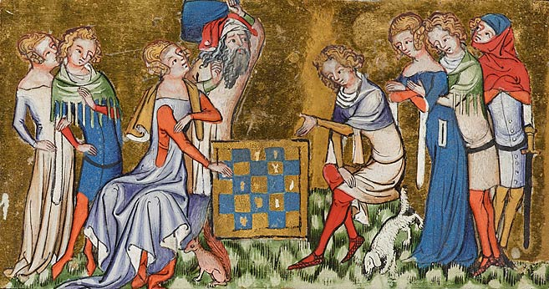
Alternating two-player zero-sum games
Players take turns
Each game outcome or terminal state has a utility for each player (e.g., 1 for win, -1 for loss, 0 for draw)
The sum of both players’ utilities is a constant
Notes:
We call such games as two player zero sum games
Zero sum means that the outcome of a game for each player is either 1 when he/she wins, or -1, when he/she looses and 0 when there is draw
Therefore the sum is always 0

Slide 10
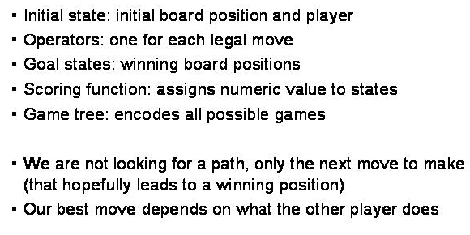
Game Tree search
CS461 Artificial Intelligence © Pinar Duygulu
Spring 2008
Notes:
We will call the players as MAX and MIN
MAX moves first and they take turns till to the end of the game
A game is formally defined as a kind of search problem
The initial state includes the board position and an indication of whose move it is
Set of operators define the legal moves that a player can make
Terminal state determines when game is over
States where the game has ended are called as terminal or goal states
Utility function gives a numeric value for the outcome of the game.
In chess it is -1. 0 or 1
In some games it can have a wider range
For example in backgammon the range is from 192 to -192

Slide 11
Optimal strategies
In a normal search problem, the optimal solution would be a sequence of moves leading to a goal state - a terminal state that is a win
In a game, MIN has something to say about it and therefore MAX must find a contingent strategy, which specifies
  MAX’s move in the initial state,
  then MAX’s moves in the states resulting from every possible response by MIN,
  then MAX’s moves in the states resulting from every possible response by MIN to those moves
  …
An optimal strategy leads to outcomes at least as good as any other strategy when one is playing an infallible opponent
CS461 Artificial Intelligence © Pinar Duygulu
Spring 2008
Notes:
If this was a normal search problem, then all MAX would do is search for a sequence of moves that leads to a terminal state
that is a winner and go ahead and make the first move in the sequence
However, in games, MIN has something to say about it
MAX therefore must find a strategy that will lead to a winning terminal state regardless of what MIN does.
The strategy includes the correct move for MAX for each possible move by MIN

Slide 12
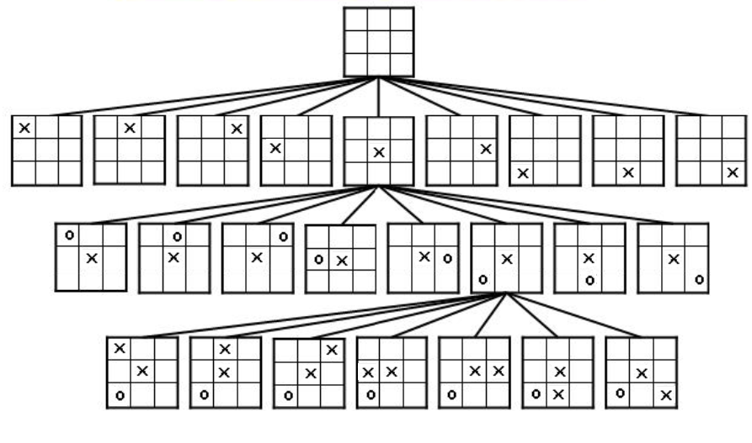
Partial Game Tree for Tic-Tac-Toe
CS461 Artificial Intelligence © Pinar Duygulu
Spring 2008
Notes:
This figure shows part of the search tree for the game Tic Tac Toe
From the initial state MAX has a choice of nine possible moves
Play alternates between MAX placing X’s and MIN placing O’s

Slide 13

Game tree
A game of tic-tac-toe between two players, “max” and “min”
Notes:
The game ends when we reach leaf nodes where one player has three in a row, column or diagonal or all the squares are filled
The number on each leaf node indicates the utility value frim the point of view of MAX
High values are assumed to be good for MAX, and bad for MIN
It is MAX’s job to use the search tree to determine the best move

Slide 14
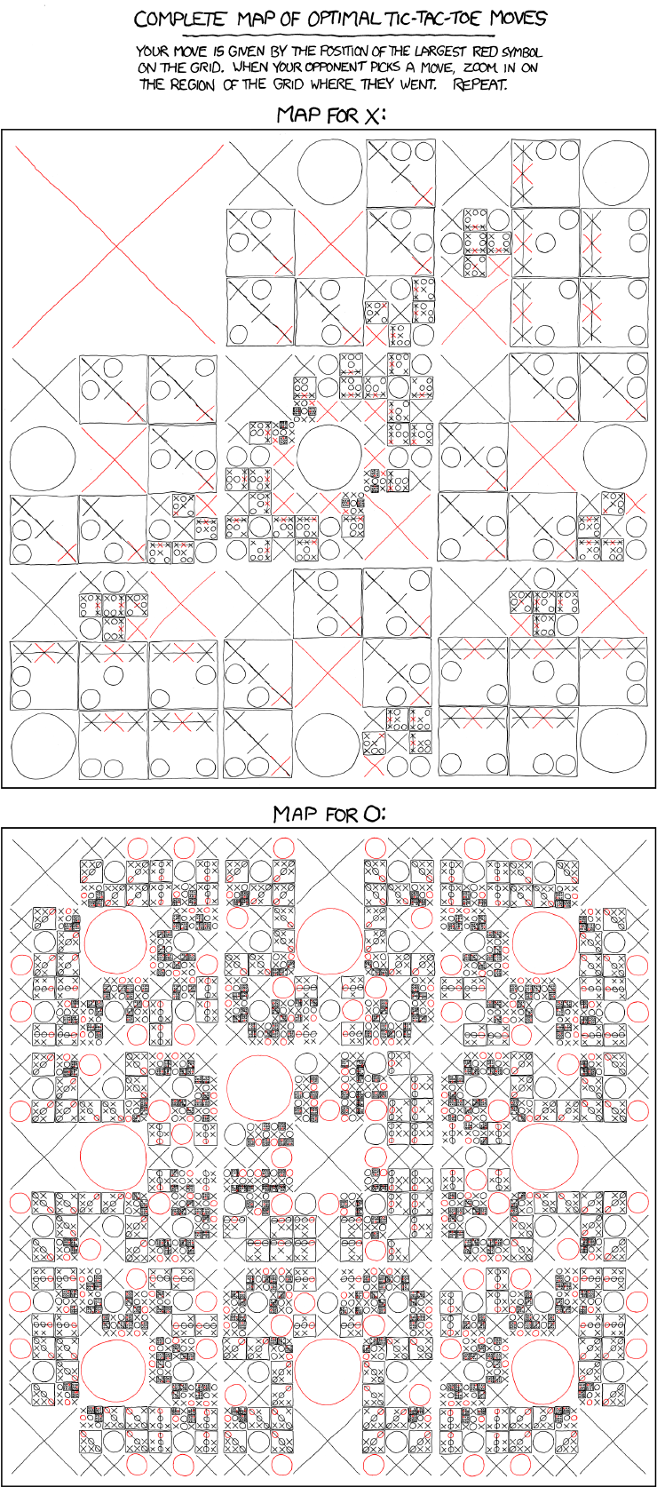

http://xkcd.com/832/

Slide 15
http://xkcd.com/832/

Slide 16

Minimax
Perfect play for deterministic games
Idea: choose move to position with highest minimax value
= best achievable payoff against best play
E.g., 2-ply game:
CS461 Artificial Intelligence © Pinar Duygulu
Spring 2008
Notes:
Even for a simple game like Tic tac Toe it is too complex to show the whole search tree
So we will work on a simple example
The positions of MAX are labelled as A1 A2 and A3
Possible responses of MIN for A1 are A11 A12 and A13, and so on
This game ends after one move each by MAX and MIN
Each half move is called as a ply
So this is a 2-ply game

Slide 17
Minimax value
Given a game tree, the optimal strategy can be determined by examining the minimax value of each node (MINIMAX-VALUE(n))
The minimax value of a node is the utility of being in the corresponding state, assuming that both players play optimally from there to the end of the game
Given a choice, MAX prefer to move to a state of maximum value, whereas MIN prefers a state of minimum value
CS461 Artificial Intelligence © Pinar Duygulu
Spring 2008
Notes:
The minimax algorithm is designed to determine the optimal strategy for MAX
And thus to decide what the best move is
We assume that both players play optimally
MAX always tries to maximize, and MIN tries to minimize
Recall that we are calculating the utilities from MAX’s perspective

Slide 18

Minimax algorithm
CS461 Artificial Intelligence © Pinar Duygulu
Spring 2008
Notes:
First, we generate the whole game tree all the way down to the terminal states
Then, we apply the utility function to each terminal state to get its value
We use the
We then continue to back up the values till we reach to the top of the tree
Utility of the terminal states to determine the utility of the nodes from the leaf nodes toward the root, one layer at a time, till we reach to the top of the tree

Slide 19
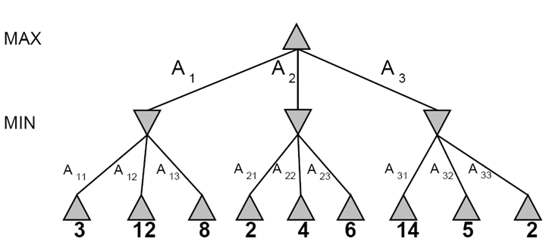
Game tree search
3
3
2
2
Minimax value of a node: the utility (for MAX) of being in the corresponding state, assuming perfect play on both sides
Minimax strategy: Choose the move that gives the best worst-case payoff
Notes:
Consider the leftmost branch in this example
MIN has to choose among A11, A12 and A13, that is 3, 12, or 8.
The best move is to choose A11. that is 3, which leads to the minimal outcome.
We will then assign 3 to the leftmost downward triangle node under the assumption that MIN will do the right thing and choose 3
Similarly we will choose 2, among 2 4 and 6 for the middle branch
And 2 among 14, 5 and 2 for the rightmost branch

Slide 20
MINIMAX-VALUE(root) = max(min(3,12,8), min(2,4,6), min(14,5,2))
= max(3,2,2)
= 3
3
3
2
2
Minimax(node) =
  Utility(node) if node is terminal
  max_{action} Minimax(Succ(node, action)) if player = MAX
  min_{action} Minimax(Succ(node, action)) if player = MIN
Notes:
Eventually the backed up values reach to the top of the tree
MAX choses the move that will lead to the highest value
In our example
At topmost triangle node, MAX has a choice of 3, 2 and 2
MAX’s best move is A1 that is 3
This is called as minimax decision
Because it maximizes the utility the assumption that the opponent will play perfectly to minimize it

Slide 21
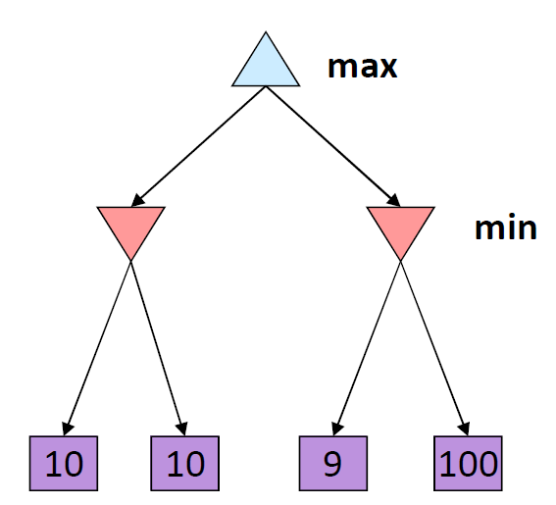
Optimality of minimax
The minimax strategy is optimal against an optimal opponent
What if your opponent is suboptimal?
  Your utility can only be higher than if you were playing an optimal opponent!
  A different strategy may work better for a sub-optimal opponent, but it will necessarily be worse against an optimal opponent
11
Example from D. Klein and P. Abbeel
Notes:
What happens if the opponent is not optimal?
In this case, your utility will be higher than if you were playing to an optimal opponent
For example here, let’s assume that MIN chose 11 instead of 10 on the left, and 9 on the right
MAX will get 11 rather than 10
If MIN somehow choses 100 then MAX would have 100 which is much higher than expected from an optimal opponent

Slide 22
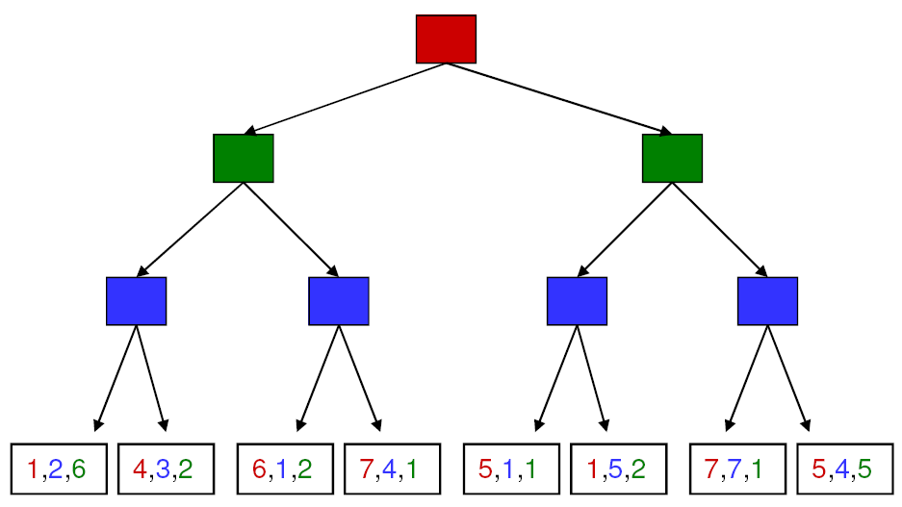
More general games
4,3,2
4,3,2
1,5,2
4,3,2
7,4,1
1,5,2
7,7,1
More than two players, non-zero-sum
Utilities are now tuples
Each player maximizes their own utility at their node
Utilities get propagated (backed up) from children to parents
Notes:
What happens if there are more than 2 players
Now we try to maximize the utility of each single player at their node
For example
Among 1,2,6 and 4,3,2 blue’s utilities are shown in blue, that is 2 and 3
And when it is blue’s turn blue will choose 3, therefore 4,3,2
For the next move among 6,1,2 and 7,4,1 . That is among 1 and 4blue will choose 4, and therefore 7,4,1 will move up
From 5,1,1, and 1,5,2 , 1,5,2 will go up
And 7,7,1 and 5,4,5 7,7,1 will go up
Now, it is green’s turn
On the left among 4, 3, 2 and 7, 4, 1 green has options 2 and 1 so will choose 2 and therefore 4, 3, 2 will go up
On the right among 1, 5, 2 and 7, 7, 1 green has options 2 and 1 again so will choose 2 and therefore 1, 5, 2 will go up
Finally at the root, when it is red’s turn
Among 4. 3. 2 and 1, 5, 2 red’s choices are 4 and 1, and therefore will choose 4,3,2
Now, at the end of the game the utilities are 4 for red, 3 for blue and 2 for green respectively

Slide 23
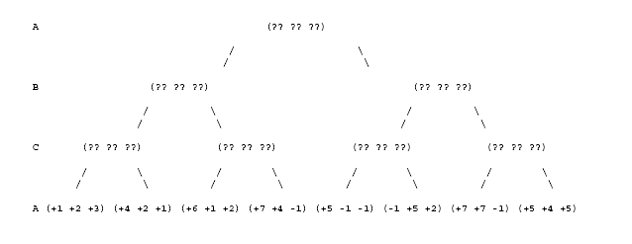
Tree Player and Non-zero sum games
(+1 +2 +3)
(+1 +2 +3)
(-1 +5 +2)
(+1 +2 +3)
(+6 +1 +2)
(-1 +5 +2)
(+5 +4 +5)
CS461 Artificial Intelligence © Pinar Duygulu
Spring 2008
Notes:
Let’s consider another example, where players are A, B and C, and the utilities are listed in alphabetical order
When it is C’s turn,
Among 1 2 3, and 4, 2, 1 C will choose 1 2 3
Among 6 1 2 and 7 4 -1 C will choose 6 1 2
Among 5 -1 -1 and -1 5 2 c will choose -1 5 2
And
Among 7 7 -1 and 5 4 5 C will choose 5 4 5
When it is B’s turn
Among 1 2 3 and 6 1 3 B will choose 1 2 3
Among -1, 5, 2 and 5, 4, 5 B will choose -1, 5, 2
Finally when it is As turn
Among 1 2 3 and -1 5 2 A will choose 1 2 3

